Slide 1

CUSTOMER ANALYSIS
DESCRIPTIVE ANALYSIS

Slide 2
Task TO-DO
Revenue per State.
Revenue based on Month of the Year.
Revenue based on Age.
Quantity-Discount percentage correlation.
Percentage of Revenue per Region.
Revenue per Category per Gender.
Build the dashboard.

Slide 3
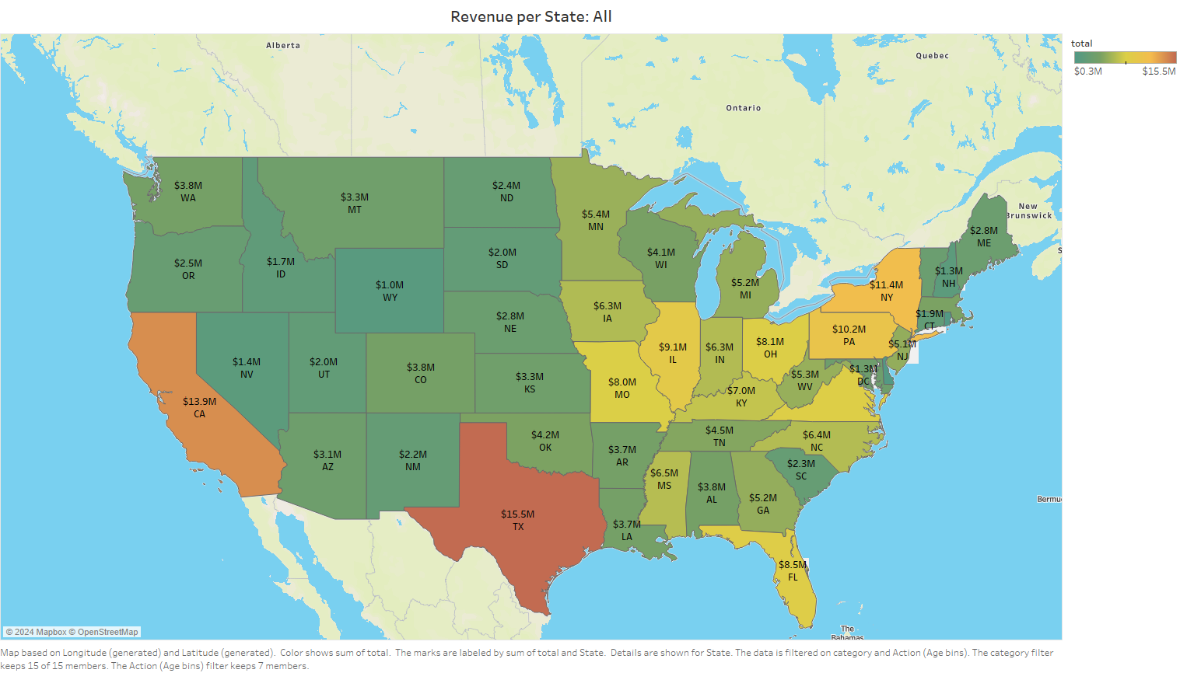
Revenue per State

Slide 4
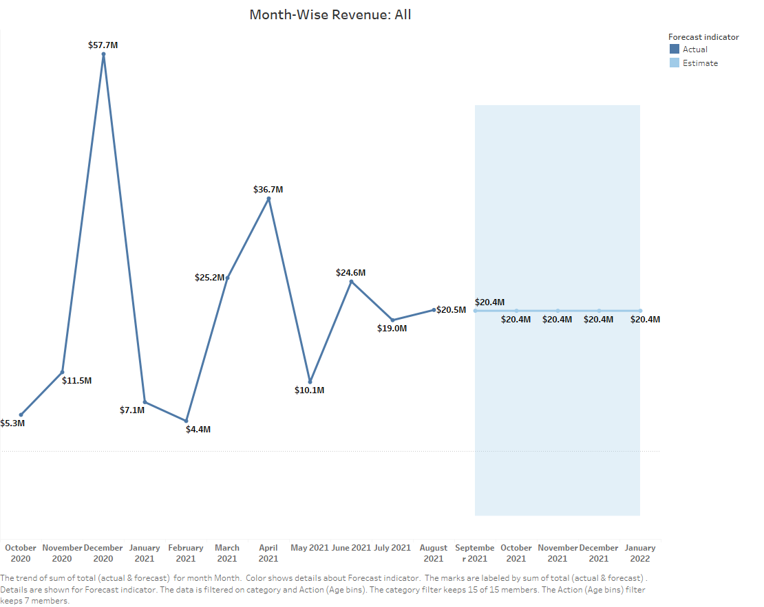
Revenue based on Month of the Year

Slide 5
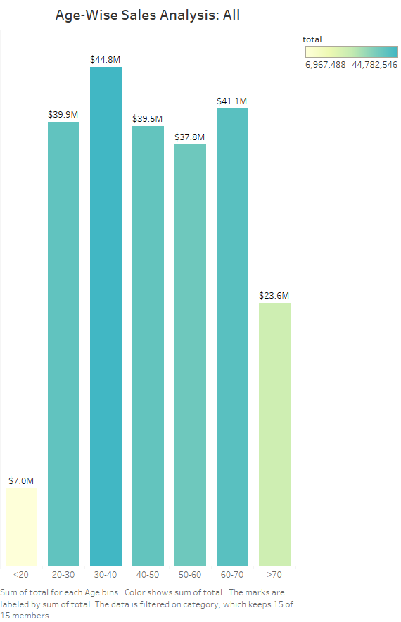
Revenue based on Age

Slide 6
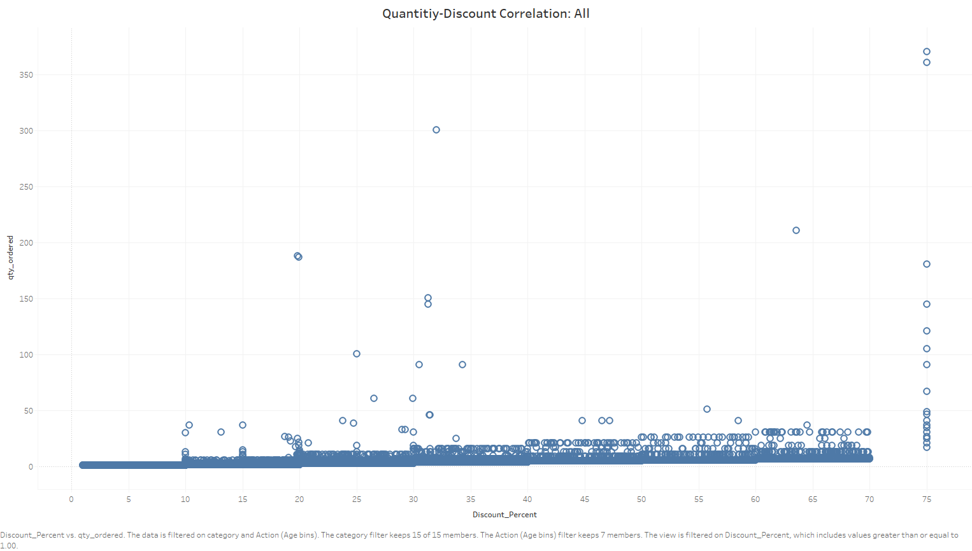
Quantity-Discount percentage correlation

Slide 7
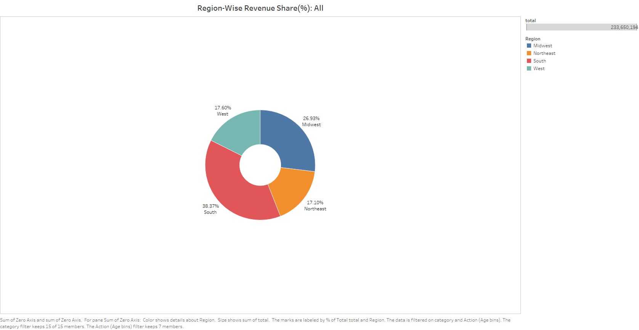
Percentage of Revenue per Region

Slide 8
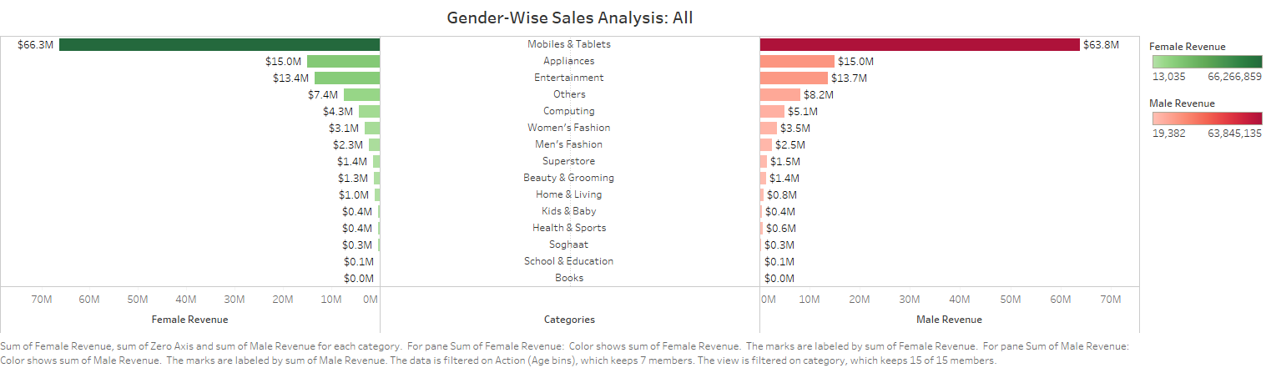
Revenue per Category per Gender

Slide 9
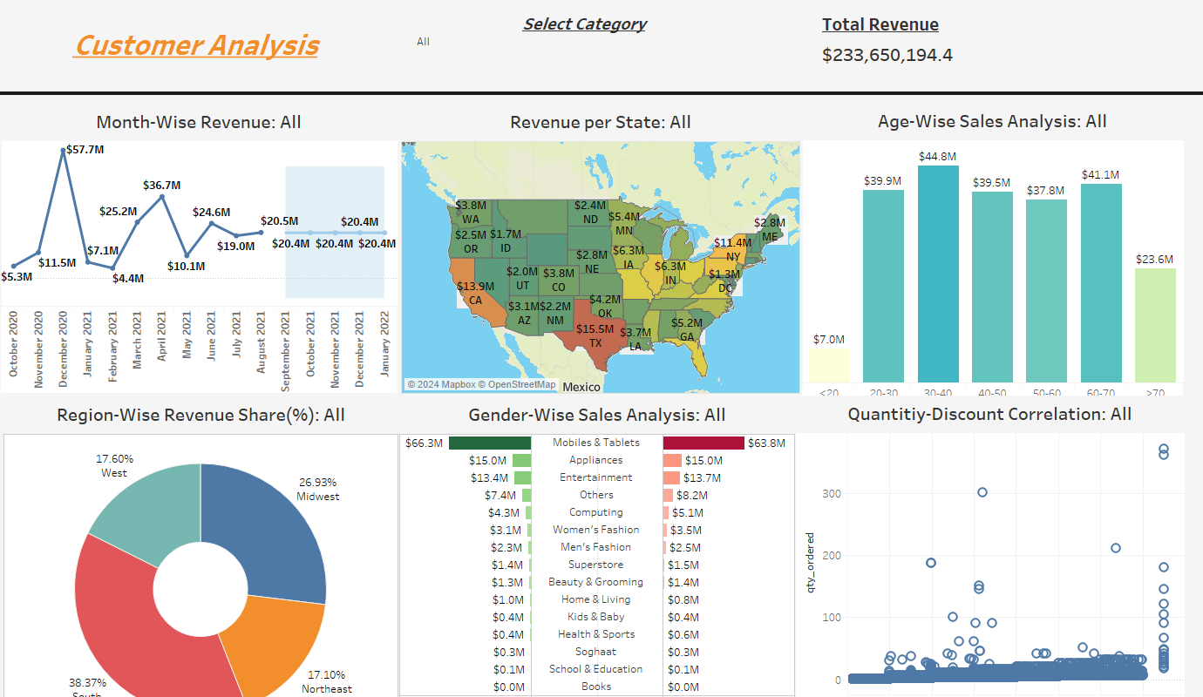
Dashboard

